Slide 1
How Climate Change Effects Flood
Group Members:
Ahmed Aqil
Shayan Malick
Umer Murtaza

Slide 2
The Data WorkFlow
Data Information
Data Collection
Data Cleaning
In modern days there are numerous satellites orbiting Earth sending data with various time intervals. They are recorded at different spatial resolution.
We read about how this data is collected and what basic knowledge do we need to understand this data. This was due to the fact that various different file formats are used to store this data efficiently.
Last step was too clean the data so that it can be used for machine learning. This is one of the most important step of our research.

Slide 3
Sources of Data
Satellite Data
Local Data
Flood Reports / News
Most of our Data is extracted from NetCDF files. Sources include:
ESA CCI
TerraClimate
gridMET
NASA-USDA
NOAA
Local data was provided by Pakistan Meteorological Department but it was not enough so we combined it with data from previously mentioned sources.
These sources were used to collect data manually. Data collected from these sources are what are some of the most inland flood prone areas and in what years flood occurred.

Slide 4
Current Data Constraints
The parameter that indicates if the flood occurred at the location was difficult to analyse, since we had to decide on what will it be based on.
‘True or False’ (1 or 0) for indication by going through the news and marking respectively.
Detect ‘water’ pixels from satellite images and determine any anomalies, then this combined with data from sensors present in the area that detect the water level for indication of flood.
Collecting data for variety of other parameters that ‘might’ have an impact on floods. But this will increase the complexity of our dataset, since we might not have knowledge about field specific variables. So there is a chance that we will modify the dataset for better performance in future.

Slide 5
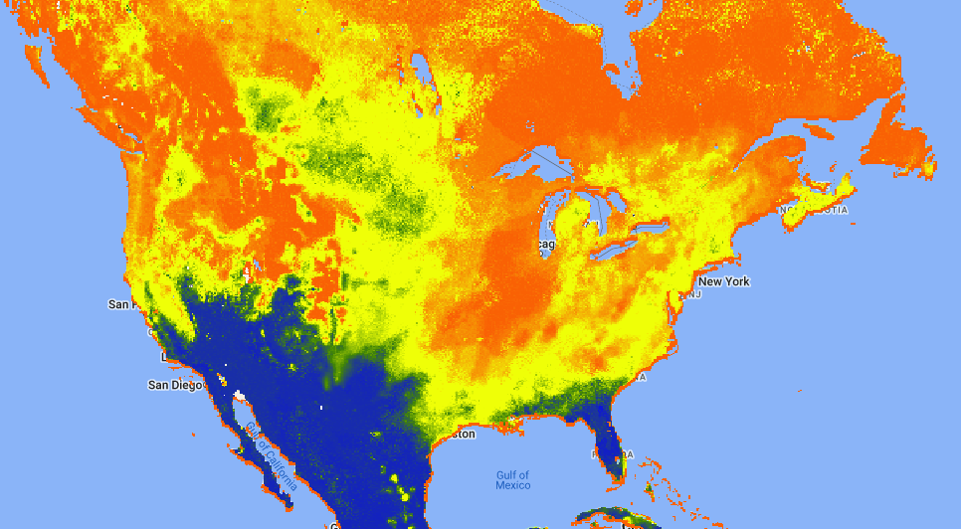
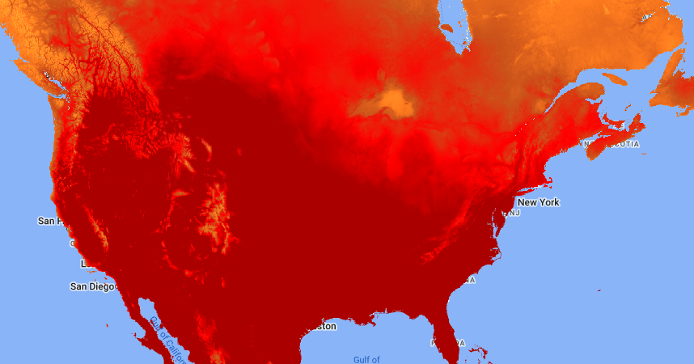
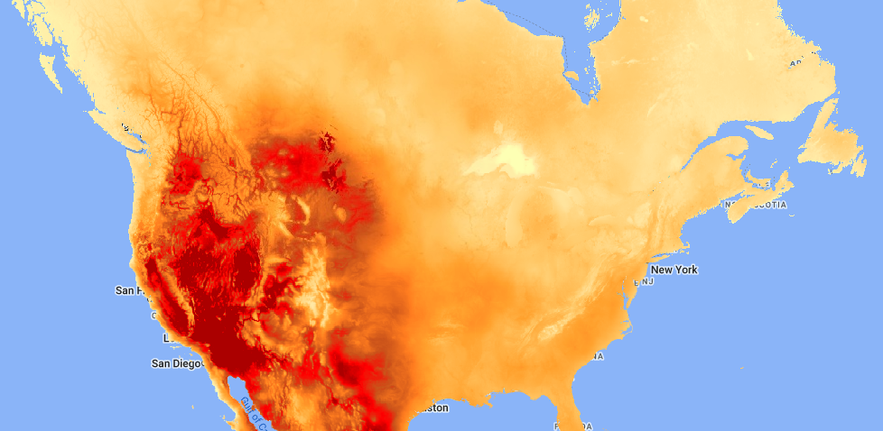
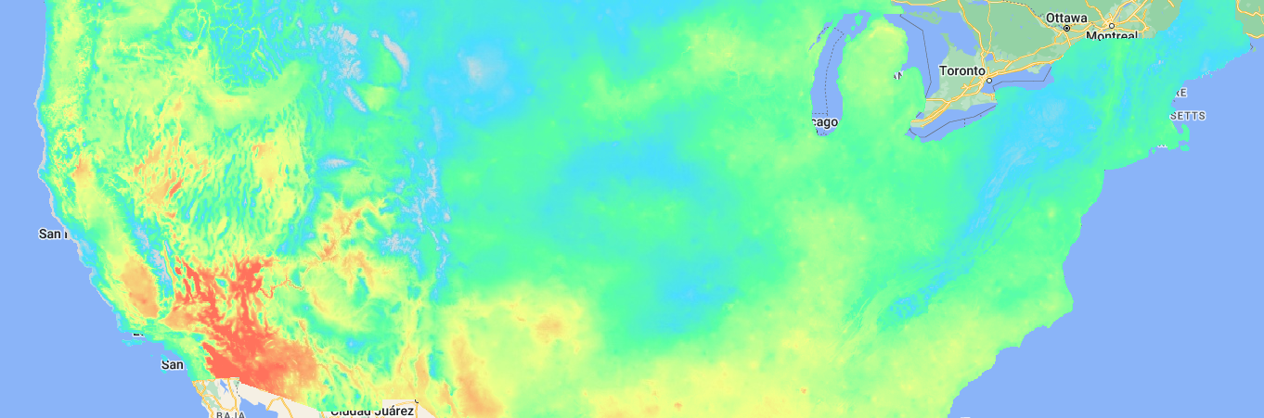
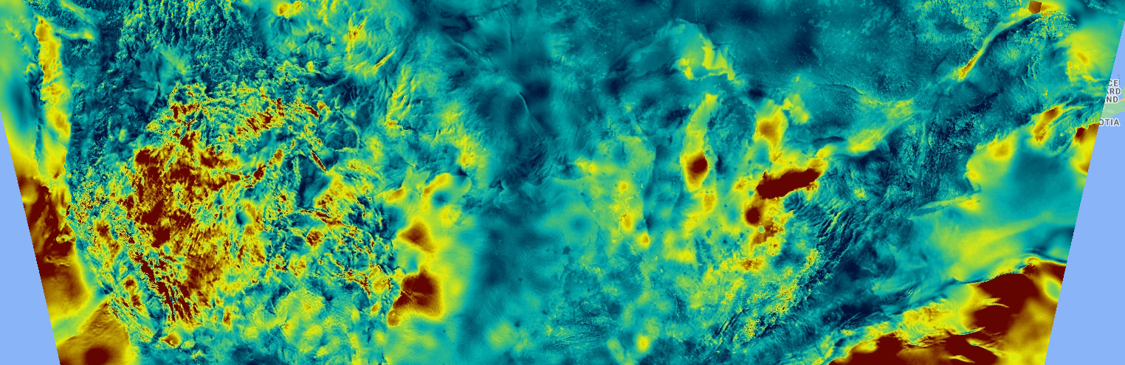
Soil Moisture DataSet
Temperature DataSet
TerraClimate DataSet
gridMET DataSet
RTMA DataSet

Slide 6
Implementation
According to our current understanding of the topic we have used these as base models to give an idea of how thing will work out in the project.
As we will continue to read research papers, the models used might get modified but the general plan of the data usage and error calculation will remain the same.
Using Machine Learning Models and other Techniques

Slide 7
WorkFlow
Selection on the basis of theoretical working of models and suitable techniques
Using Graphs and other methods to analyse the parameters
Data Collection
Data Cleaning
Select Suitable Models and Techniques
Train and Test Models
Analysis
Check the results and after analysis we need to tune the models and data for better efficiency

Slide 8
The Approach
There are two ways that we know of through which we can forecast Flood:
Parameter Based Prediction: We can train models that will learn the relationship between different parameters independent of time and then make predictions / forecast using these parameters.
Time Series Based Prediction: The model will also work out how the gradual change in time affects the parameters and make predictions by inferring to that information.
VAR
Long Short-Term Memory
Vector Auto Regression (VAR) is a statistical model used to capture the linear interdependencies among multiple time series variables. It assumes that the current value of each time series can be explained by a linear combination of its past values and the past values of all other time series in the model.
Since we have data in multivariate time series format for each location we can use LSTM to make forecast using previously recorded values and inferred dependency for the variable in context.

Slide 9
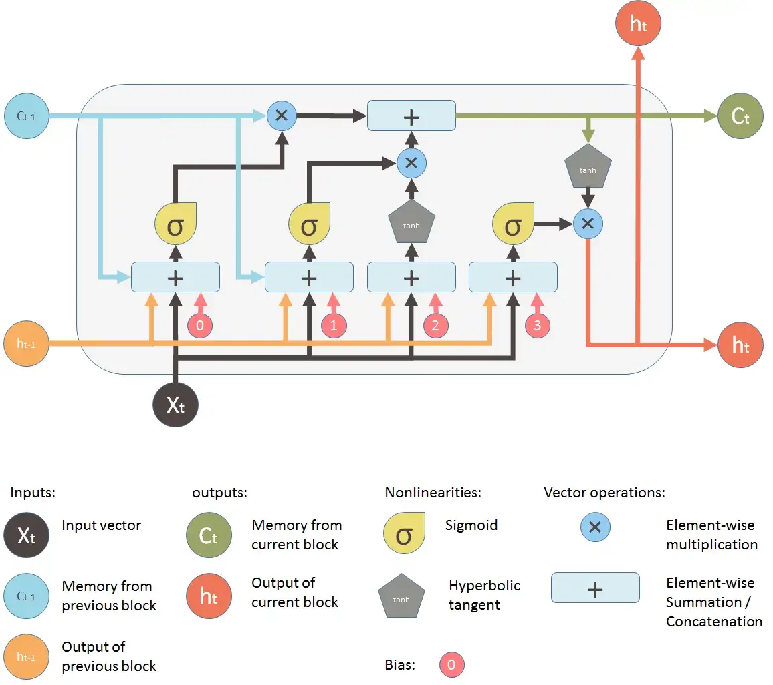
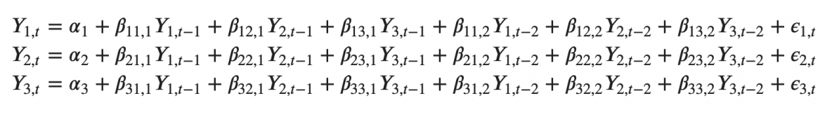
Working of Models
VAR Analysis
LSTM Model

Slide 10
Data Analysis
Using Statistical Methods to gain more insight about the parameters and then using this information to tune the models hence increasing efficiency

Slide 11
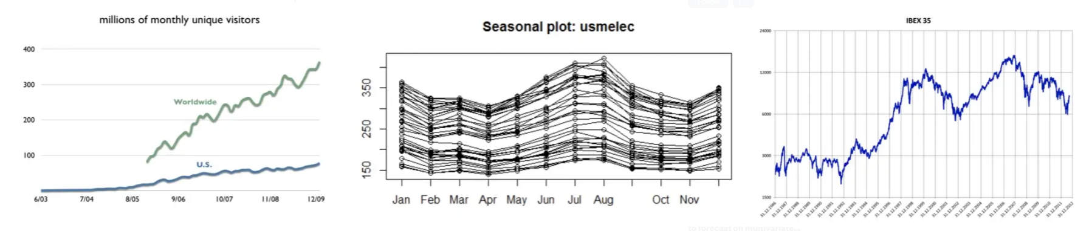
Patterns to look for when selecting Model
Trend: Long-term increase or decrease in the data. The trend can be any function, such as linear or exponential, and can change direction over time.
Seasonality: Repeating cycle in the series with fixed frequencies (hour of the day, week, month, year, etc). A seasonal pattern exists of a fixed known period.
Noise: The random variation in the series.
Cyclicity: Occurs when the data rise and fall, but without a fixed frequency and duration caused, for example, by economic conditions.

Slide 12
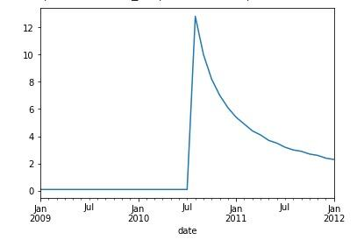
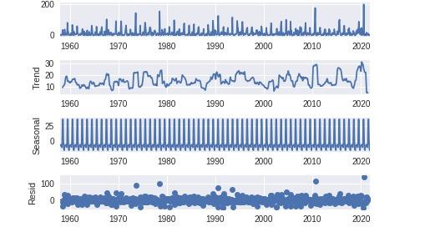
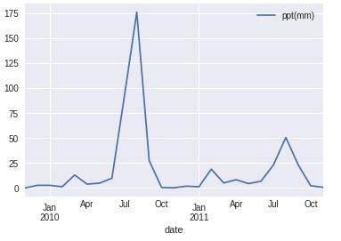
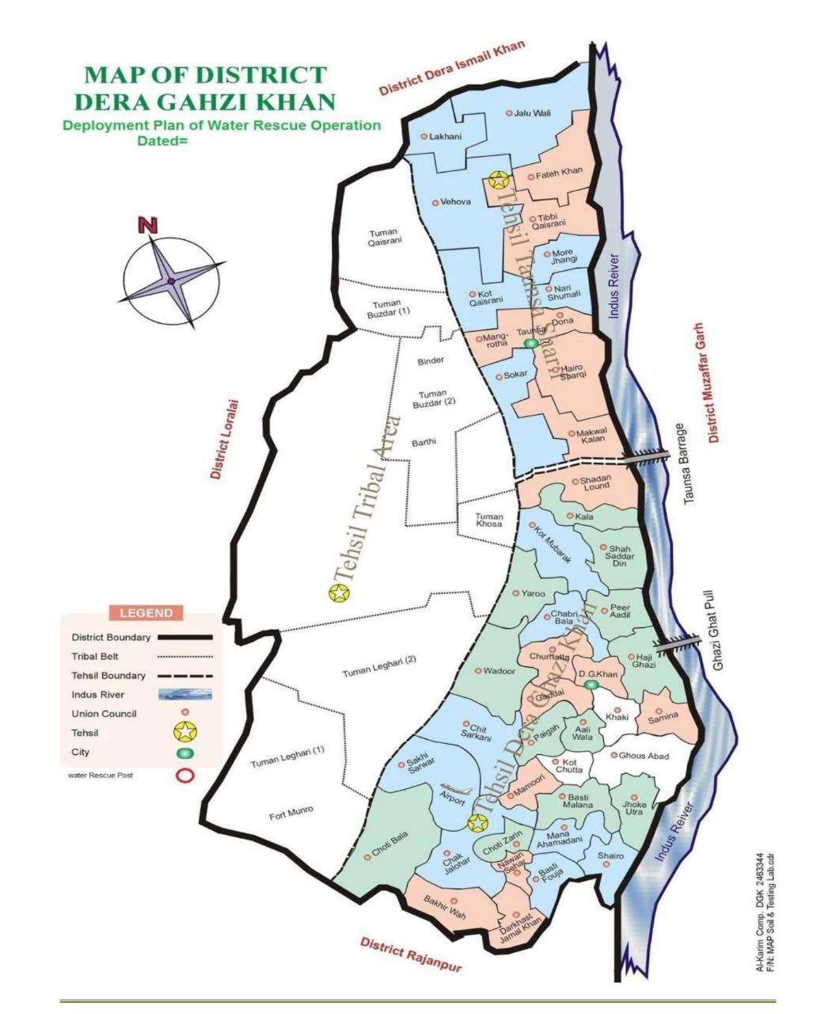
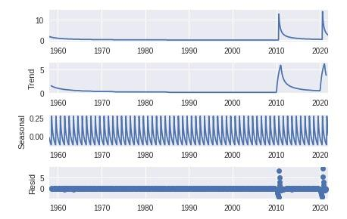
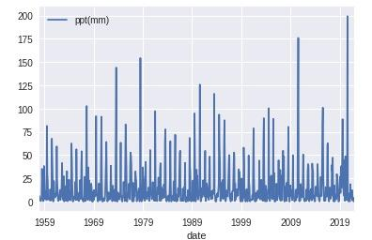
Data for Dera Ghazi Khan
Trend and Seasonality
Data Plot

Slide 13
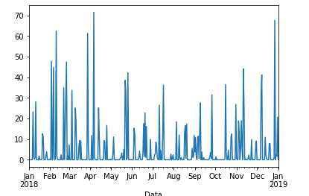
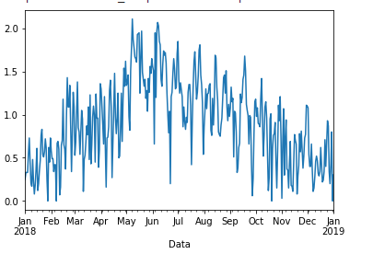
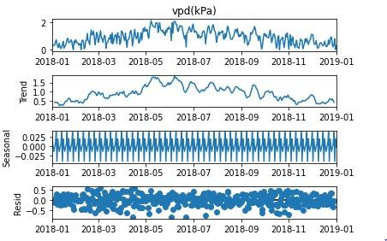
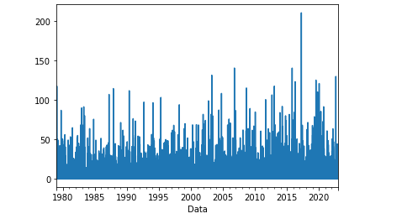
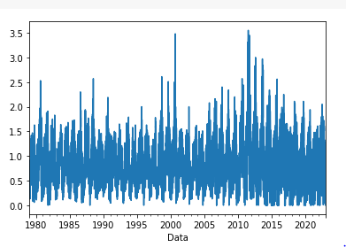
Data for Mississippi River
Rain
Vapor Pressure Deficit

